Slide 1
Canonical Correlation

Slide 2
Today . . .
  The basic goal of canonical correlation analysis
  A simple example
  Interpretation

Slide 3
Canonical correlation finds the linear combinations of variables in two sets that are maximally correlated across sets but orthogonal within sets.

Slide 4
X₁
X₂
X₃
X₄
.
.
.
X_{q}
Y₁
Y₂
Y₃
Y₄
.
.
.
Y_{p}
What is the best way to understand how the variables in these two sets are related?

Slide 5
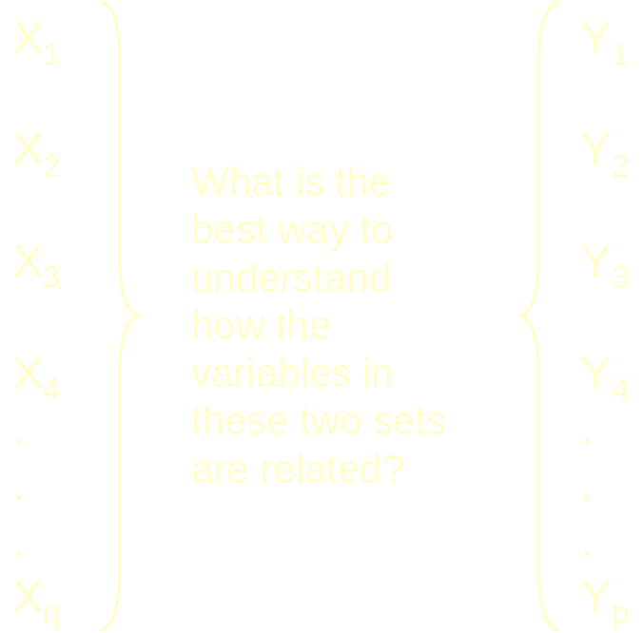
Bivariate correlations across sets (pq)
Multiple correlations across sets (p+q)
Principal components within sets; correlations between principal components across sets

Slide 6
X₁
X₂
X₃
X₄
.
.
.
X_{q}
Y₁
Y₂
Y₃
Y₄
.
.
.
Y_{p}
What linear combinations of the X variables (u) and the Y variables (t) will maximize their correlation?

Slide 7
b₁X₁
+
b₂X₂
+
b₃X₃
+
b₄X₄
+
.
+
b_{p}X_{p}
= u
a₁Y₁
+
a₂Y₂
+
a₃Y₃
+
a₄Y₄
+
.
+
a_{q}Y_{q}
= t
What linear combinations of the X variables (u) and the Y variables (t) will maximize their correlation?

Slide 8
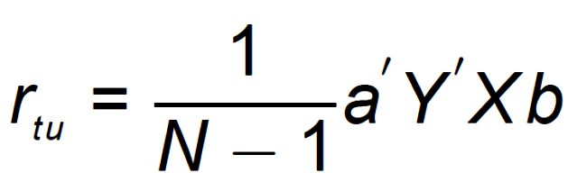
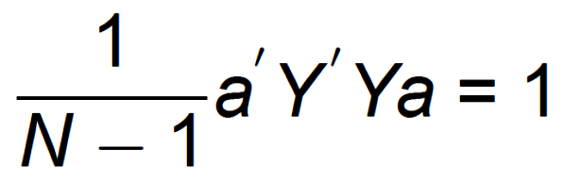
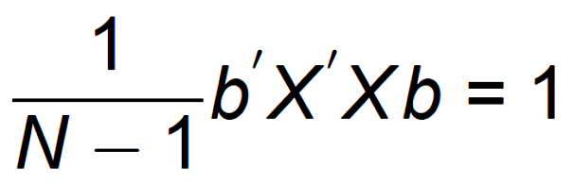
If X and Y are in standard score form, and
u = Xb
t = Ya
then find a and b to maximize r_{t,u}:
while

Slide 9
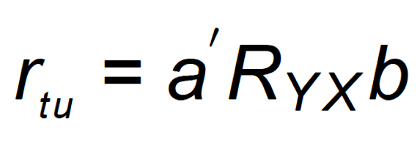
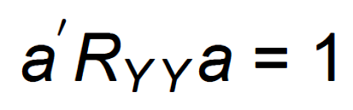
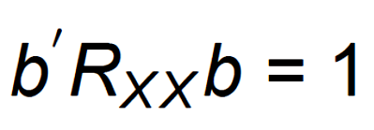
If X and Y are in standard score form, and
u = Xb
t = Ya
then find a and b to maximize r_{t,u}:
while

Slide 10
X₁
X₂
X₃
Y₁
Y₂
Y₃
X₁
1.00
r_{X1X2}
r_{X1X3}
r_{X1Y1}
r_{X1Y2}
r_{X1Y3}
X₂
r_{X2X1}
1.00
r_{X2X3}
r_{X2Y1}
r_{X2Y2}
r_{X2Y3}
X₃
r_{X3X1}
r_{X3X2}
1.00
r_{X3Y1}
r_{X3Y2}
r_{X3Y3}
Y₁
r_{Y1X1}
r_{Y1X2}
r_{Y1X3}
1.00
r_{Y1Y2}
r_{Y1Y3}
Y₂
r_{Y2X1}
r_{Y2X2}
r_{Y2X3}
r_{Y2Y1}
1.00
r_{Y2Y3}
Y₃
r_{Y3X1}
r_{Y3X2}
r_{Y3X3}
r_{Y3Y1}
r_{Y3Y2}
1.00

Slide 11
X₁
X₂
X₃
Y₁
Y₂
Y₃
X₁
1.00
r_{X1X2}
r_{X1X3}
r_{X1Y1}
r_{X1Y2}
r_{X1Y3}
X₂
r_{X2X1}
1.00
r_{X2X3}
r_{X2Y1}
r_{X2Y2}
r_{X2Y3}
X₃
r_{X3X1}
r_{X3X2}
1.00
r_{X3Y1}
r_{X3Y2}
r_{X3Y3}
Y₁
r_{Y1X1}
r_{Y1X2}
r_{Y1X3}
1.00
r_{Y1Y2}
r_{Y1Y3}
Y₂
r_{Y2X1}
r_{Y2X2}
r_{Y2X3}
r_{Y2Y1}
1.00
r_{Y2Y3}
Y₃
r_{Y3X1}
r_{Y3X2}
r_{Y3X3}
r_{Y3Y1}
r_{Y3Y2}
1.00

Slide 12
X₁
X₂
X₃
Y₁
Y₂
Y₃
X₁
1.00
r_{X1X2}
r_{X1X3}
r_{X1Y1}
r_{X1Y2}
r_{X1Y3}
X₂
r_{X2X1}
1.00
r_{X2X3}
r_{X2Y1}
r_{X2Y2}
r_{X2Y3}
X₃
r_{X3X1}
r_{X3X2}
1.00
r_{X3Y1}
r_{X3Y2}
r_{X3Y3}
Y₁
r_{Y1X1}
r_{Y1X2}
r_{Y1X3}
1.00
r_{Y1Y2}
r_{Y1Y3}
Y₂
r_{Y2X1}
r_{Y2X2}
r_{Y2X3}
r_{Y2Y1}
1.00
r_{Y2Y3}
Y₃
r_{Y3X1}
r_{Y3X2}
r_{Y3X3}
r_{Y3Y1}
r_{Y3Y2}
1.00

Slide 13
The correlation between the two sets is called the canonical correlation and is the largest possible correlation that can be found between linear combinations.
The weights (a and b) that are used to create the linear combinations are called the standardized canonical coefficients. The linear combinations created (t and u) are called the canonical variates.

Slide 14
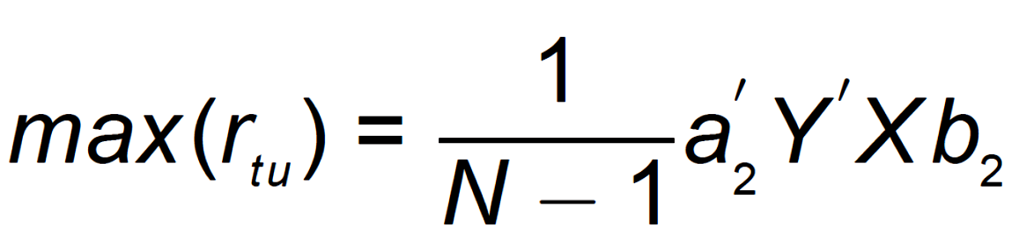
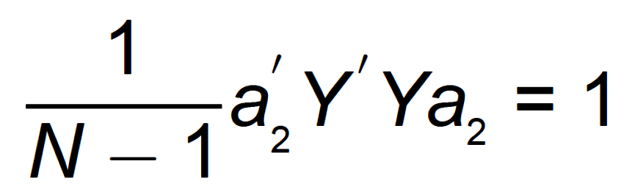
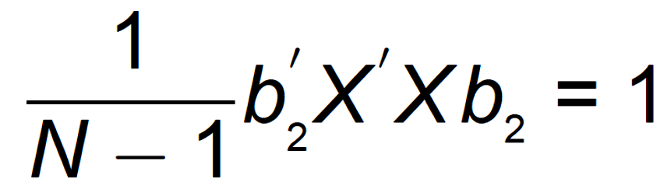
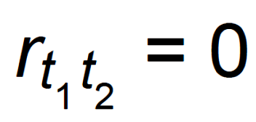
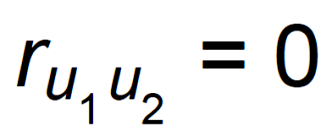
Additional canonical variates and their correlations can be found provided they satisfy:

Slide 15
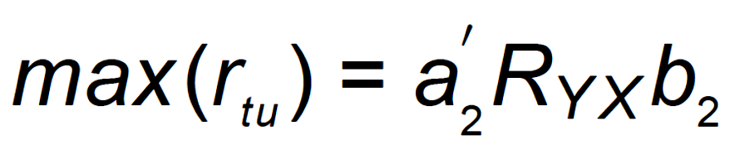
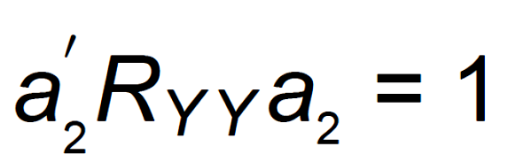
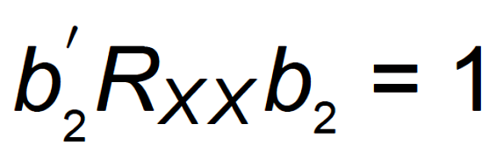
Additional canonical variates and their correlations can be found provided they satisfy:
The extraction of canonical variates can continue up to a maximum defined by the number of measures in the smaller of the two sets.

Slide 16
The standardized canonical coefficients (a and b) are interpreted in the same way as standardized regression coefficients in multiple regression—they indicate the unique contribution of a variable to the linear combination.
It is also possible to derive the correlations between each variable and the linear combination. These are called canonical loadings or canonical structure coefficients and are interpreted the same way as loadings in principal components and discriminant analysis.

Slide 17
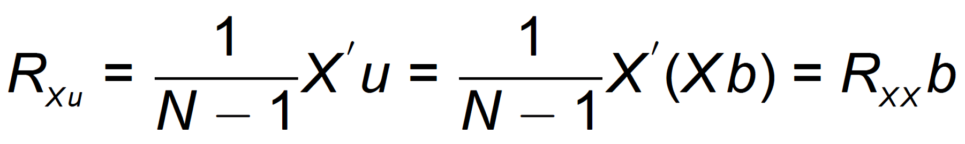
These loadings can be calculated as:
The loadings can assist in understanding the nature of the linear combinations in each set.

Slide 18
In this study, 126 college students completed a measure of the Big Five (the NEO), a measure of trait self-esteem (the Rosenberg), and measures of positive and negative affect (the PANAS).
A canonical correlation analysis can be used to determine if personality is related to feelings about the self and general affect.

Slide 19
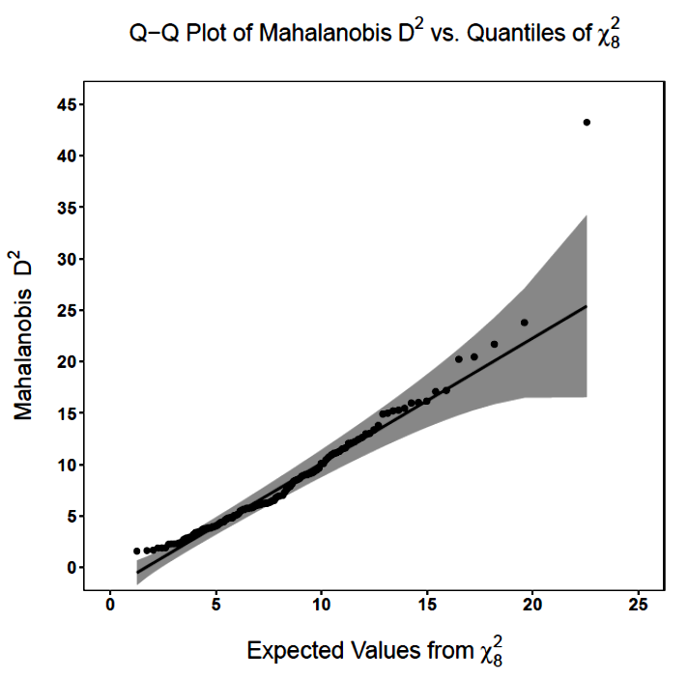
First, a little housekeeping . . .

Slide 20
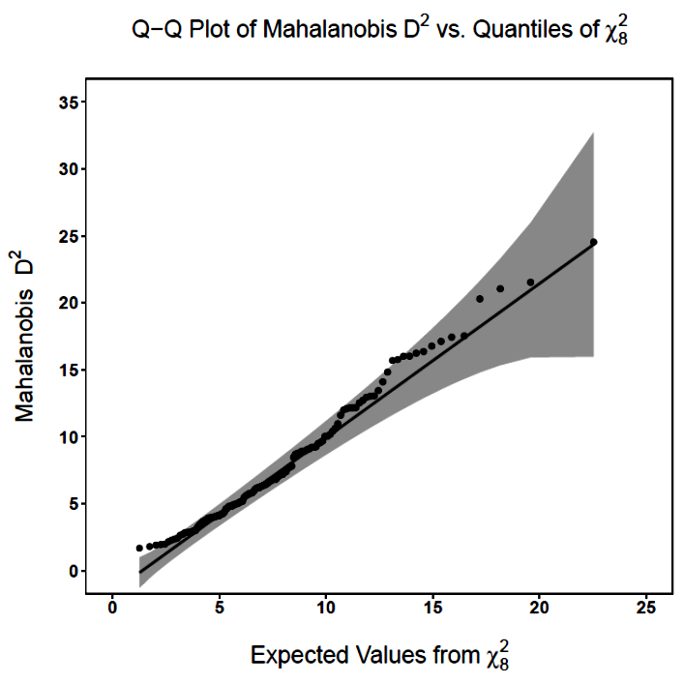
After removing the outlier . . .

Slide 21
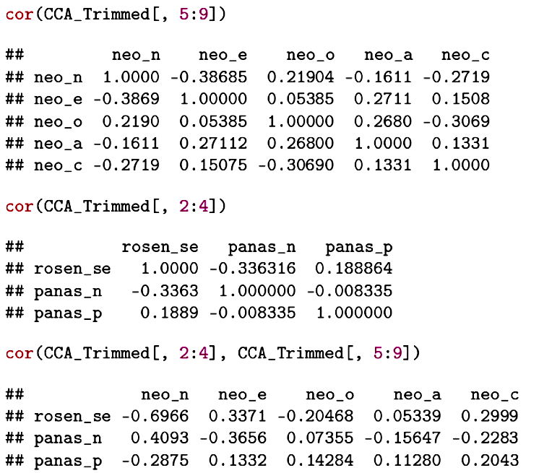

Slide 22
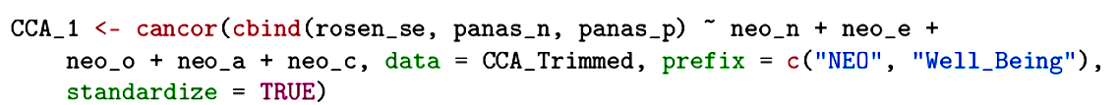
A simple canonical correlation analysis can be conducted using the cancor( ) function from the candisc package.

Slide 23
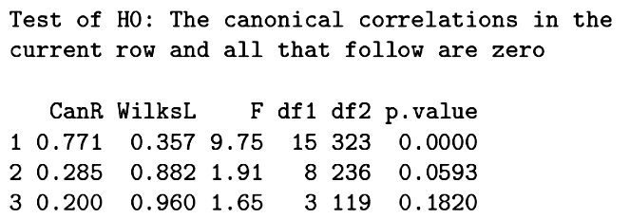
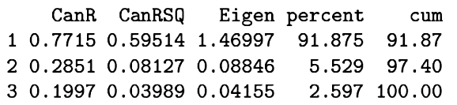
Procedures for testing the significance of the canonical correlations are applied sequentially.
At each step, the test indicates whether there is any remaining significant relationship between the sets.
In this case, one pair of linear combinations can be formed, accounting for 92% of the relationship between the sets.

Slide 24
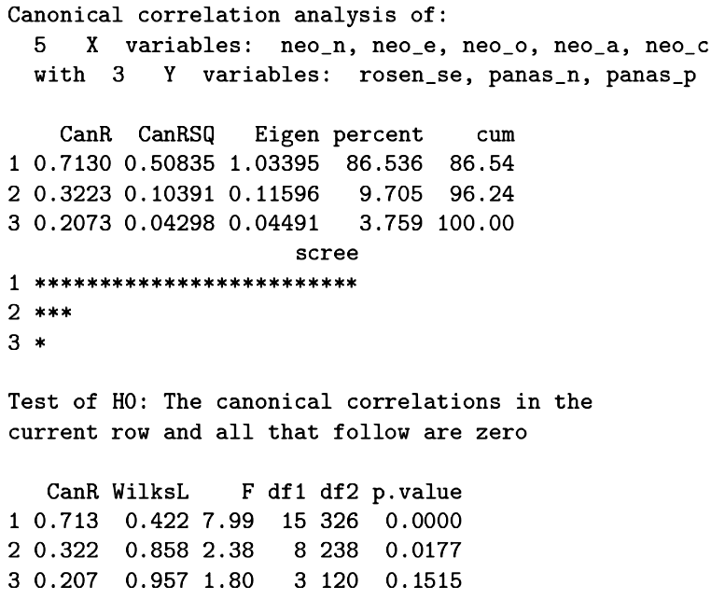
Had we not screened the data, we would have thought a second pair of linear of combinations should be interpreted.

Slide 25
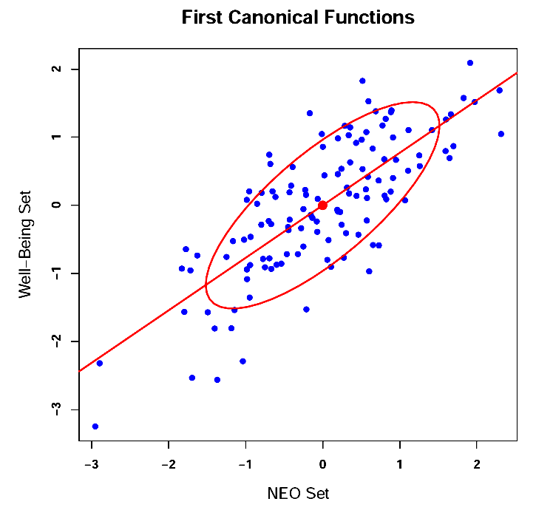

Slide 26
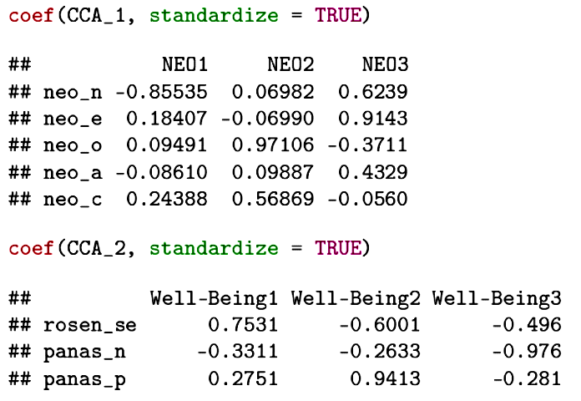
Typically the linear combinations are formed after the variables have been standardized. The weights are then interpreted as standardized regression coefficients.

Slide 27
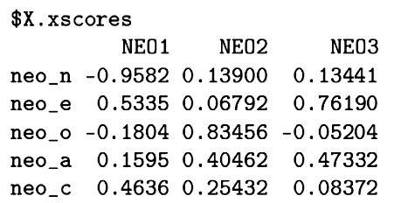
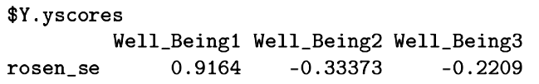

The loadings or structure coefficients are the bivariate relationships within sets, between variables and linear combinations.

Slide 28
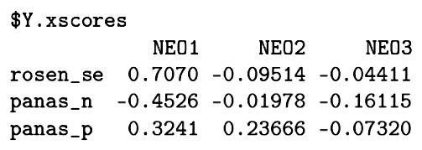
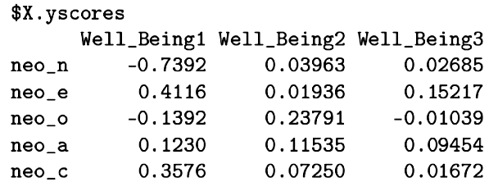
The cross loadings are the bivariate relationships between variables in one set and the linear combinations for the other set.

Slide 29
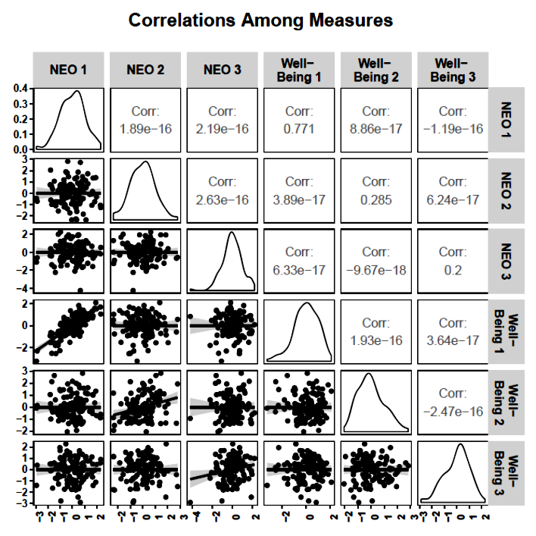

Slide 30
How much variance is
really accounted for?
Reliance on the canonical correlations for evidence of variance accounted for across sets of variables can be misleading.
Each linear combination only captures a portion of the variance in its own set. That needs to be taken into account when judging the variance accounted for across sets.

Slide 31
The squared canonical correlation indicates the shared variance between linear combinations from the two sets.

Slide 32
Each linear combination accounts for only a portion of the variance in the variables in its set.

Slide 33
Redundancy coefficients indicate the proportion of variance in the variables of Set B that is accounted for by the linear combination of variables in Set A.
These coefficients are a function of the adequacy coefficients and the squared canonical correlations.

Slide 34

Canonical Loadings
Variate 1
Variate 2
X₁
L_{1,1}
L_{1,2}
ΣL²_{1,j}
X₂
L_{2,1}
L_{2,2}
ΣL²_{2,j}
X₃
L_{3,1}
L_{3,2}
ΣL²_{3,j}
X₄
L_{4,1}
L_{4,2}
ΣL²_{4,j}
(ΣL²_{i,1})/4
(ΣL²_{i,2})/4
Adequacy Coefficients
Canonical communality coefficients

Slide 35
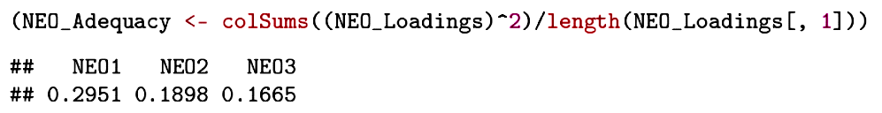
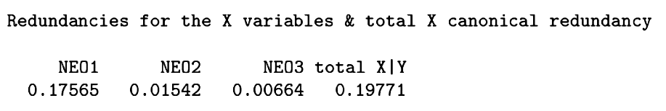
The sum of these elements squared, divided by the number of these elements is the adequacy . . .
The adequacy multiplied by the squared canonical correlation gives the redundancy.

Slide 36
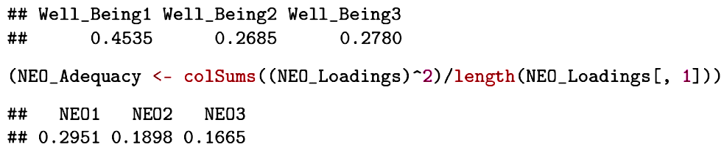
Canonical correlations will decrease in size but adequacy coefficients do not necessarily decrease in size. Why?

Slide 37
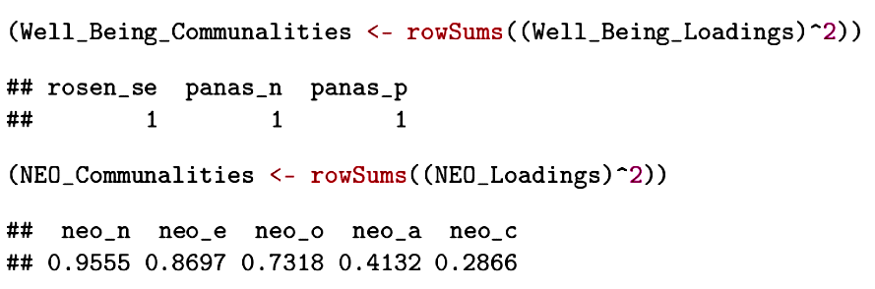
These canonical communality coefficients are equal to 1.00, but . . .
these canonical communality coefficients are less than 1.00. Why?

Slide 38
Any given loading can be squared to indicate the proportion of the variance in that variable that is accounted for by that canonical variate.
The sum of the squared loadings for a given variable indicates the total proportion of variance accounted for by the collection of canonical variates.

Slide 39
The average of the squared loadings for a canonical variate is the adequacy coefficient and indicates the proportion of variance in the collection of variables that is accounted for by the canonical variate.
The redundancy coefficient is the proportion of variance in a set of variables that is accounted for by a linear combination from the other set.
The sum of the redundancy coefficients gives the total proportion of variance in one set that is accounted for by the other set. These will usually be different values for each set.

Slide 40
Next time . . .
Assumptions, cross-validation, capitalization on chance.

